Slide 1
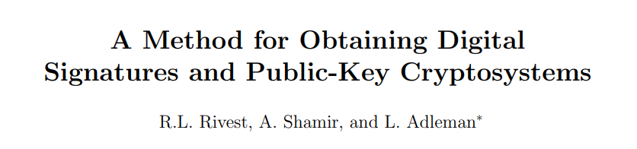
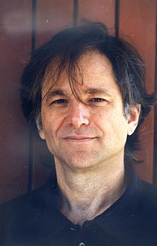
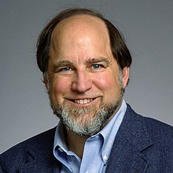

RSA encryption
Pratyush Ranjan Maharana

Slide 2
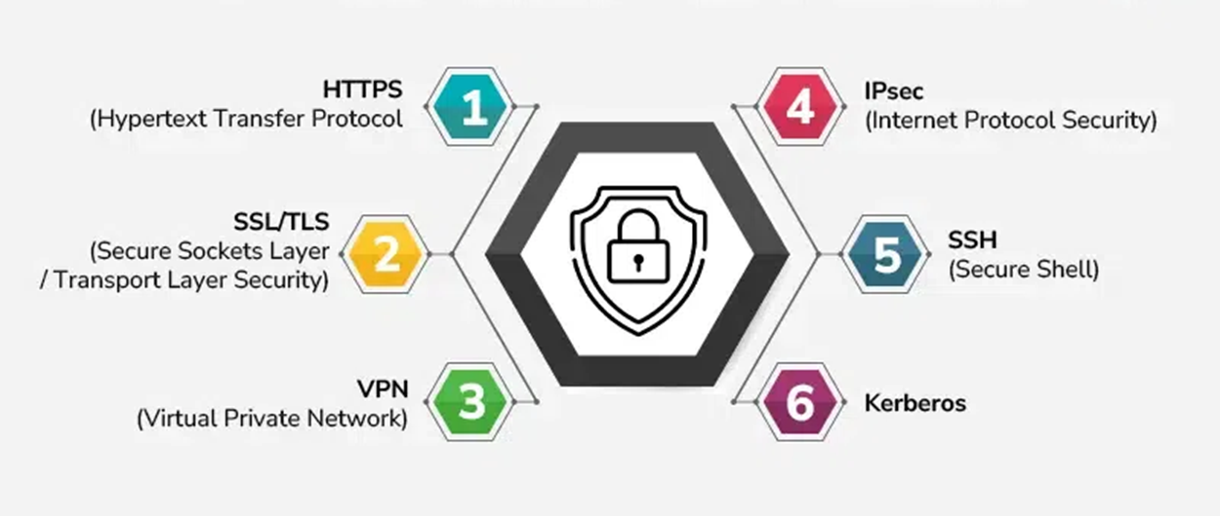
Secure connections
refers to a connection that uses encryption protocols to protect the data being transferred

Slide 3
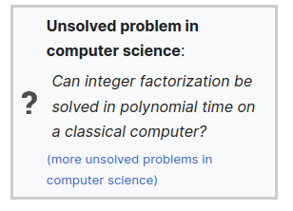

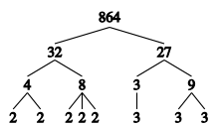
Prime Factorization
Modern encryption methods are specifically designed so that decoding them would take so long they are practically unbreakable.
It would take a classical computer around 300 trillion years to break a RSA-2048 bit encryption key. The age of the universe is only 13.8 billion years.
263130836933693530167218012159999999
What are the prime factors of this number?

Slide 4


Encrypted Message
Key

Slide 5
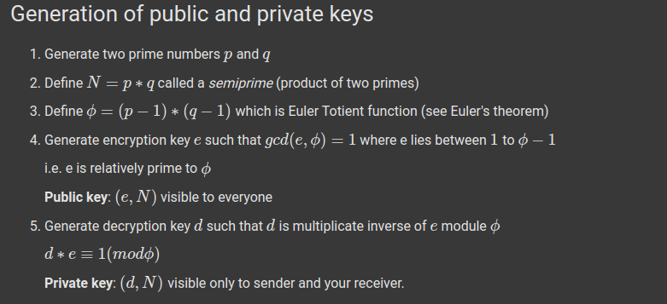

How RSA encryption works
oh mai god woww!!!!

Slide 6

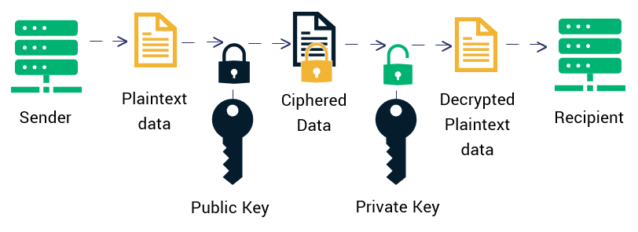


Slide 7
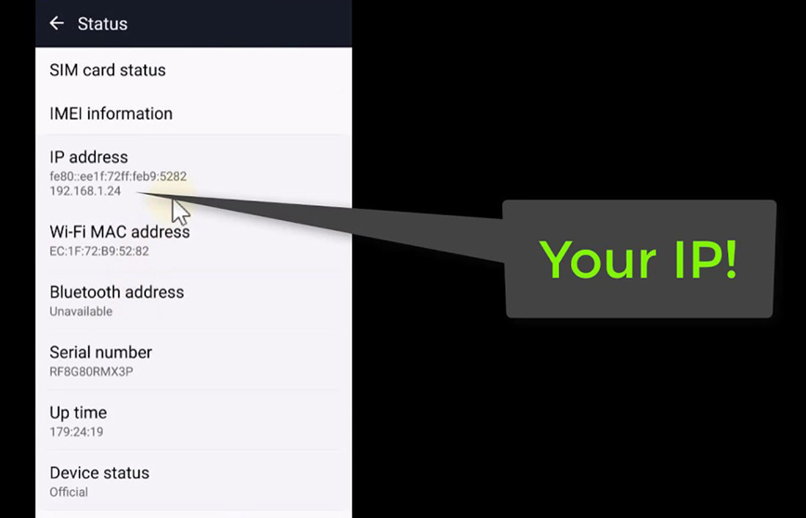

Website tracking us !!!!
Cookies
IP address
http referrer
Browser fingerprinting

Slide 8
References
RSA Encryption algorithm
https://people.csail.mit.edu/rivest/Rsapaper.pdfwikipedia
https://www.youtube.com/watch?v=YQw124CtvO0&t=149s

